Slide 1
Making this resource work for you
Prior to teaching this lesson, please refer to the ‘Unit Overview and Planning Document’.
Further guidance on planning Science Mastery lessons can be found in the detailed planning guidance document.
Refer to the ‘notes’ section on each slide for useful information, including suggested expositions, pedagogical content knowledge, suggested questions, answers and more. Consider using presenter mode so you can see this guidance throughout the lesson.
The introduction slides can be adapted to suit your teaching style and the needs of your class.
Before the lesson, adapt the fix-it slide to address any misconceptions identified in the previous lesson’s exit ticket.
Choose from the suggested activities to suit your class. The intention is not that you complete all of these, but that you select those which ones are most appropriate for your students. It may be appropriate to further adapt activities for your students.
These lessons are designed to occupy approximately 1 hour. To adapt for a shorter or longer lesson duration we advise you to adapt the activity section accordingly.
Please consider using the final slide to send feedback about this lesson or examples of PowerPoints that you have adapted to our design team. Your feedback is used to improve Science Mastery for all of our teachers and students. We appreciate all suggestions and comments.
Thank you for reading!
The Science Mastery Team

Slide 2
Biodiversity
Answer the following questions:
State the definition of an organism.
State the definition of a population.
What do plants compete for?
Describe where producers are always found in food chains or webs.
Calculate the mean of the following numbers:
12, 15, 18, 11, 24
Any living thing
A group of the same organisms (the same species)
Water, light, minerals and space.
At the start/at the bottom/as the first level
12+15+18+11+24 = 80
80 / 5 = 16
Notes:
Purpose: to assess learning at the beginning of the new unit and interleave key prior knowledge from B1.3.
Foundation question: Explain the difference between predators and prey.
Answer: Predators are carnivores that eat the prey (prey is often herbivorous)
Stretch question: Compare the resources that plants and animals compete for and explain why they are not the same.
Answer: Although plants and animals both compete for space, this is more to allow them to obtain the other resources they need. Plants need water and light to photosynthesis, which animals do not, because they do not contain chloroplasts, but rather eat plants/animals to obtain their food. Plants also need minerals to form the compounds required for photosynthesis and growth. Unlike animals, plants do not compete for food because they make their own, and they do not compete for mates because they either self or cross pollinate.

Slide 3
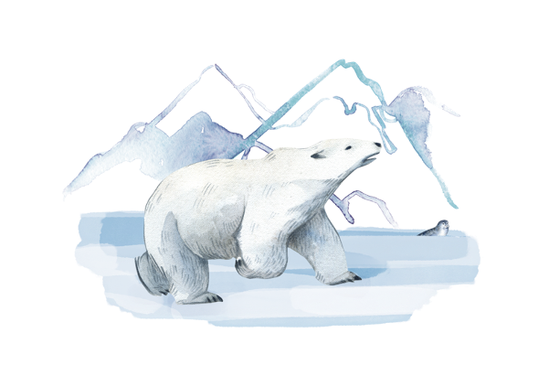
B3.2.2
12/12/2024
Biodiversity
B3.2.1 Prior Knowledge Review
B3.2.2 Biodiversity
B3.2.3 How Humans Affect Biodiversity
B3.2.4 How Humans can Preserve Biodiversity
B3.2.5 The Effect of Pollution on Biodiversity
B3.2.6 Global Warming
B3.2.7 Taking It Further: Pyramids of Biomass
B3.2.8 Taking It Further: Farming and Biotechnology
B3.2.9 Taking It Further: Food Security
Notes:
Big Idea: Organisms are Interdependent
In this unit pupils will be introduced to the concept of biodiversity and learn why it is so important for the survival of organisms as part of the big idea ‘organisms are interdependent’. In this particular lesson pupils will learn what is meant by biodiversity, why high biodiversity is important for a stable ecosystem and how scientists investigate biodiversity with different sampling techniques.
Suggested Hook:
Ecologists are scientists that study ecosystems, the communities that live there and how these organisms can be affected by changes to the environment. Currently, in the World, their role is extremely important as we are entering a period of time where human activities are threatening biodiversity across the world and contributing to climate change. In order to know what is happening to ecosystems ecologists need to measure how many organisms are in an ecosystem at any given time- they do this by sampling.

Slide 4

Following this lesson, students will be able to:
State the definition of biodiversity
Describe how biodiversity can be measured
Explain why high biodiversity is important for an ecosystem
Key Words:
biodiversity
abundance
sample
quadrat
transect
ecosystem
Notes:
Can be edited depending on class need.

Slide 5
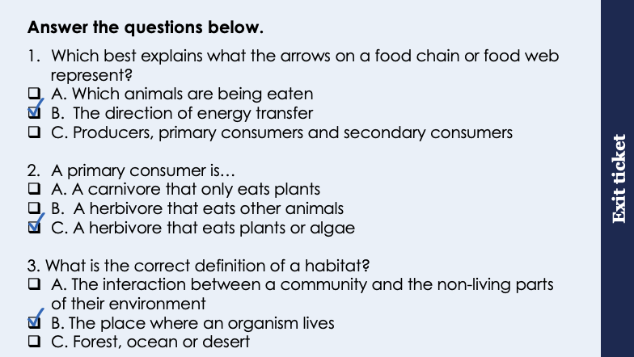
This is the fix-it portion of the lesson
The fix-it is an opportunity to respond to gaps in knowledge, especially those identified by the previous lesson’s exit ticket.
The teacher should customise this slide as needed, to facilitate
reteach, explanation, demonstration or modelling of ideas and concepts that students have not yet grasped or have misunderstood.
practise answering specific questions or of key skills.
redrafting or improving previous work.
Notes:
Purpose: to spend time on any gaps identified in previous learning from exit ticket feedback.
Fix it guidance from previous exit ticket:
Q1. Answer: B
If students answer A or C, they need practice on food webs. To fix it, it may be useful to practice further questions like Q1 on the worksheet for this lesson where they need to identify the scientific terminology for different populations.
Q2. Answer: C
If students answer A or B, they may not understand key words from a food web. To fix it you could use a food web and ask pupils to identify a herbivore/carnivore/omnivore or primary/secondary consumer and explain how they know from the food web.
Q3. Answer: B
If students answer A or C, they have most likely confused ecosystem and habitat or given the specific habitats rather than the definition. To fix it you might come up with examples of animals/plants that pupils know and ask them to identify the habitat. e.g polar bear: sea ice (Arctic).

Slide 6
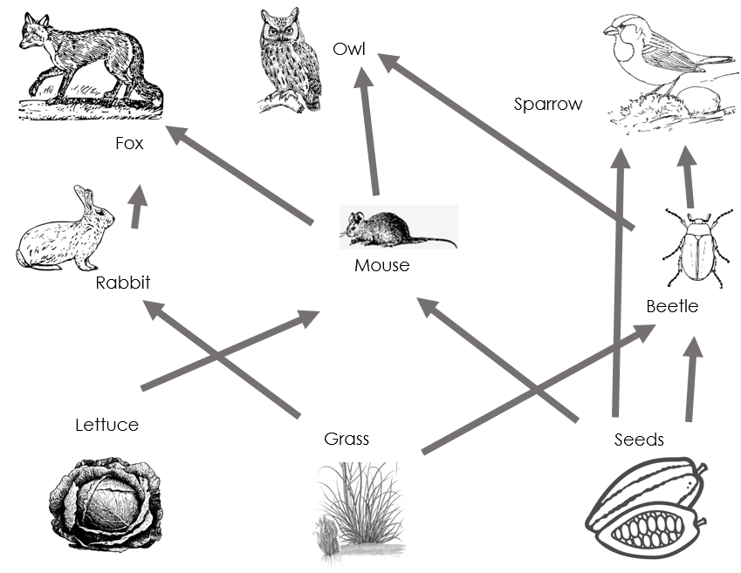
Biodiversity
Biodiversity is the variety of all the different species in an ecosystem
High biodiversity means that an ecosystem is stable
Each species is not dependent on just one other species
Notes:
Purpose: introducing new knowledge
Exposition Type: Explanation
Suggested Script:
Biodiversity refers to the variety of life break down the word on the board Bio- life, diversity – variety. This variety includes different species in an ecosystem but also the genetic variety within a species. What is an example of variety within a species that is due to genetics? Any- eye colour, fur colour, size etc. It is important that species are diverse as it makes it more likely that that a particular species will be able to survive and reproduce. The same can be said for diversity in an ecosystem. An ecosystem that has high biodiversity is said to be stable. This means that within an ecosystem a species is less likely to be solely dependent on another species for food or shelter and therefore will be less affected if the population of another species decreases. Use the food web on the screen and a smaller example to illustrate this. In the smaller food web if one population decreases/is removed many other species will be negatively affected. In a larger food web when one population decreases another can often take its place as a source of food.
Pupils have already done this practical in Unit B1.3 so this should be a recap with the focus on the technique and using the keywords. The focus for the rest of the unit is the effect of decreasing biodiversity, how humans are affecting it and what can be done to prevent this.
Note: variety of different species includes the variety within species. This is a common misconception with pupils – they can understand that biodiversity is the variety of different species but not understand that within a species there is genetic variation.

Slide 7

Think outside the box!
Why is biodiversity something that humans should be concerned about?
How many different foods do humans eat?
What would happen if we only had one food source?
What would happen if that food source was at risk?
Notes:
Guidance:
One of the biggest misconceptions in this topic is the separation of humans/self with the natural world. It is important for pupils to understand that they themselves are part of a number of ecosystems. There is also a disconnect with humans understanding that they are part of food chains, where they assume that because they are not physically killing animals themselves, they are not predators.
This talk task can be useful with a bit of thinking time and then can be opened up into more of a debate, where pupils can add/extend/change statements or opinions.
A good example that pupils may have learned about in history is the Irish potato famine, but there are many examples in countries that are heavily dependent on rice or grains.

Slide 8
Biodiversity
Biodiversity of a habitat can be measured using sampling techniques
This is a method of counting the abundance of different species
Name of habitat sampled | Number of different plant species
Football field | 4
Forest | 17
Farmland | 2
Notes:
Purpose: introducing new knowledge
Exposition Type: Explanation
Suggested Script:
We learnt in year 7 (B1.3) about different sampling techniques that scientists use to investigate the abundance and distribution of different species in an ecosystem. Both these techniques used the piece of equipment on the screen. What is the name of this piece of equipment? A quadrat. You may want to write and practice saying the word quadrat out load with pupils as an ‘I say, you say’. Especially if they could not remember the name of it.
Looking at this results table showing the number of plant species in three different habitats, we can see that the biodiversity is different. Which habitat has the greatest biodiversity? Forest. How do you know? Because it has 17 different plant species, whereas the football field and farmland only have 4 and 2. So we can measure biodiversity like this and monitor where biodiversity is low; this is important because we might have to do something about it to increase biodiversity and ensure ecosystems are stable.
Image source:
https://commons.wikimedia.org/wiki/File:Quadrat_sample.JPG

Slide 9
Sampling techniques
The two most common sampling techniques are:
Random sampling
Placing quadrats at random coordinates
Used for investigating the number of organisms in a species, species diversity or percentage cover
1 2 3
1 2 3 4 5
Systematic sampling
Placing quadrats at regular intervals along a transect line
Used for investigating the effect of an abiotic factor
8
7
6
5
4
3
2
1
Notes:
Purpose: introducing new knowledge
Exposition Type: Explanation
Suggested Script:
The first type of sampling that can be used is random sampling. This is used to estimate the number of a species in an area. A quadrat is placed randomly using coordinates in an area of known size and the species of interest inside the quadrat are counted. This is repeated many times in an area and the recordings are used to calculate a mean number of a species per quadrat which can then be used to estimate the total number of organisms from a species in that area, percentage cover or species diversity. Show the example image explaining that a grid of 5 by 3 square is mapped over the area to be sampled and random coordinates generated, then the quadrat is placed there and the organism counted. This is repeated many times. In this image coordinate 3,2 was used.
The second type of sampling investigates the effect of an abiotic factor on the distribution of a species. What does abiotic mean? Non living. What could be some examples of abiotic factors that could effect distribution of a species? Light intensity, water, man made structures such as a road etc. To carry out systematic sampling a transect line and a quadrat are used. The transect is placed moving away from the abiotic factor being investigated (eg away from the road or away from the pond) and a quadrat is placed at regular intervals along the transect line. The number of organisms inside the quadrat is recorded at each interval.
Very common misconception – that quadrats are just used for random sampling and that a transect is the piece of equipment for systematic sampling, which is not the case. All sampling involves quadrats as they are just the frame used to count the organisms. The transect is the straight line through (usually different) habitats
e.g.
if you wanted to estimate the number of flowers in a field you would use random sampling to calculate a mean and then use that to estimate the total number in the field, based on its area (this is not a calculation that pupils are expected to do at this point)
if you wanted to investigate the effect of water on the growth of a certain species you would use systematic sampling to make a transect line through different habitats (e.g. woodland, river, marsh) and use quadrats at regular intervals to determine if there are significant differences.

Slide 10
Quick Quiz
Determine if the following statements are true or false:
Biodiversity is the variety of different species in an ecosystem
Low biodiversity means that species are not dependent on only one food source
Sampling techniques can be used to measure the abundance of different species
Biodiversity only refers to species of plants
A transect is used to randomly sample the species diversity within a habitat
True
False
True
False
False
Notes:
Purpose: review of new information.
Guidance:
Use thumbs up or down to determine true or false and correct false statements, allowing thinking time before 3,2,1 to prevent copying. Use cold calling to explain why answers are true or false. If pupils are still struggling with basic recall of these concepts it may be necessary to spend more time on review before moving on to the rest of the recap.
Answers
True
False – high biodiversity allows this, low biodiversity means it is much more likely that species have fewer food sources.
True
False – biodiversity refers to all organisms in an ecosystem
False – quadrats are used at random coordinates for random sampling, transect is used to determine the effect of a factor on the distribution of a species.

Slide 11

Is this correct?
Humans don’t need to worry about biodiversity because it does not affect us directly
Notes:
Suggested guidance:
Talk tasks can be used in a variety of ways to suit the particular needs of the students you are teaching. Through exchanging views with others, students develop their understanding of the science beyond what could be achieved individually.
Science classrooms that successfully integrate talk have the following features:
Science talk is a regular feature of lessons and is woven into classroom activities.
Students are paired or grouped strategically by the teacher to ensure productive interaction. This might take into consideration the students’ proficiency of the English language, how encouraging they might be to peers and their attainment in the topic. It’s a good idea to consider these pairings in the class seating plan.
Students are encouraged and supported to talk, but are not forced to talk.
The teacher should take on the role of a facilitator, engaging with conversations where necessary and encouraging or steering the conversation where needed.
Students are encouraged to use the language they have to express their ideas (e.g., everyday language, imperfect English, native language), but also to incorporate science specific terminology where this is more accurate or has been taught.
6. Scientifically inaccurate ideas are not dismissed by the partner or teacher; open discussion and further investigation are relied on to help students construct ideas that support them to progress in their scientific understanding.
7. Guidelines for behaviour during talk tasks are explicit and frequently reviewed. Rules for students might be:
Listen carefully to your partner
Take turns talking.
Speak one at a time, without interrupting.
Politely agree or disagree and explain why.
Politely point out if your partner has used a scientific word incorrectly, if they have explained the science incorrectly, or if there is a more accurate way to describe something.
If confused, ask questions.
Stay focused on the discussion topic.
Respond to one another.

Slide 12
Drill
Define biodiversity
Name the two sampling techniques used to measure biodiversity
Name two pieces of equipment required for these sampling techniques
Calculate the total area of a field if it is 20m long and 40m wide.
Describe how you would expect the distribution of plants to change as you move further away from a large, shady tree.
Explain your answer.
Name one biotic factor
Name one abiotic factor
Notes:
Purpose: This is a knowledge drill. The purpose of this is to check that the critical knowledge is secure before pupils move onto independent practice.
Suggested guidance: There are a range of ways this could be done depending on time and ability range of the class:
Mini whiteboards
As full sentences in exercise books
As short answers in exercise books
In the pupil workbook
As pair talk
As cold call

Slide 13
Drill answers
Biodiversity is the variety of all the different species in an ecosystem
Random and systematic
Quadrat and tape measure
20 x 40 = 800m²
The number of plants would increase
More sunlight means the plants can photosynthesis more and grow.
Predators, prey availability, disease
Sunlight, pH of soil, water, temperature, nutrient availability, moisture levels of the soil
Notes:
Purpose: This is a knowledge drill. The purpose of this is to check that the critical knowledge is secure before pupils move onto independent practice.
Suggested guidance: There are a range of ways this could be done depending on time and ability range of the class:
Mini whiteboards
As full sentences in exercise books
As short answers in exercise books
In the pupil workbook
As pair talk
As cold call

Slide 14

I: Describe to recall facts, events or processes in an accurate way
Example question:
To ‘describe’, your answer should:
Use bullet points to keep your answer clear
Cover enough points to fully answer the question
Use scientific keywords in your answer
‘Say what you see’ if there is a diagram, graph or table.
Describe a method to estimate the population of daisies in a field that is 20m x 20m.
Model answer:
Place a quadrat at a set of coordinates chosen by a random number generator
Count the number of daisies in the quadrat
Repeat at other coordinates
Calculate a mean number of daisies in each quadrat
Area of field = 20 x 20 = 400m²
Area sampled = 400m² x number of quadrats used
Estimated pop size = (total area) x mean number of daisies
area sampled
Notes:
This slide models the process of answering a describe question.
Firstly, students are presented with a generic describe question, along with a model answer. Students are also given some simple guidance to follow for producing their own describe answer.
The generic question and answer should be used by the teacher to remind students of
the key features of a great answer
how to structure their answer
why the model answer is a good example
Following this, students will be required to apply this process to answer their own describe question, which will appear in place of the generic questions. This describe question will be specific to the topic students are learning about in the lesson. Give students time to write their own answer to this, ensuring that they use the guidance provided. To further scaffold this task for students, it may be appropriate to:
pair students up to write an answer together
list for students the key words you would like them to include in the answer
provide a writing frame or ‘points to include’ for students
A model answer for this question will appear. Teachers should review the model answer with students by referencing the guidance in the green box. For example ‘we can see item 1 in the guidance is to identify the general pattern in the graph. Notice in the model answer here we have done just that’. Or ‘item 2 in the guidance here says that we should separate the graph into sections and describe each section. Has this been achieved in the model answer? Where can we see this?’.

Slide 15
We: Describe to recall facts, events or processes in an accurate way
Example question:
Describe a method to investigate how the increasing distance from the school affects the number of daisies growing in the field.
To ‘describe’, your answer should:
Use bullet points to keep your answer clear
Cover enough points to fully answer the question
Use scientific keywords in your answer
‘Say what you see’ if there is a diagram, graph or table.
Model answer:
Lay out a transect (at 90 degrees to the school)
Place quadrat at intervals along the transect
Count the number of daisies at each distance
Repeat
Calculate the mean at each distance
Notes:
This slide models the process of answering a describe question.
Firstly, students are presented with a generic describe question, along with a model answer. Students are also given some simple guidance to follow for producing their own describe answer.
The generic question and answer should be used by the teacher to remind students of
the key features of a great answer
how to structure their answer
why the model answer is a good example
Following this, students will be required to apply this process to answer their own describe question, which will appear in place of the generic questions. This describe question will be specific to the topic students are learning about in the lesson. Give students time to write their own answer to this, ensuring that they use the guidance provided. To further scaffold this task for students, it may be appropriate to:
pair students up to write an answer together
list for students the key words you would like them to include in the answer
provide a writing frame or ‘points to include’ for students
A model answer for this question will appear. Teachers should review the model answer with students by referencing the guidance in the green box. For example ‘we can see item 1 in the guidance is to identify the general pattern in the graph. Notice in the model answer here we have done just that’. Or ‘item 2 in the guidance here says that we should separate the graph into sections and describe each section. Has this been achieved in the model answer? Where can we see this?’.

Slide 16
You: Describe to recall facts, events or processes in an accurate way
Example question:
Describe a method to investigate how the increasing distance from a river affects the number of dandelions in a field. You should explain how to use a transect in your method.
To ‘describe’, your answer should:
Use bullet points to keep your answer clear
Cover enough points to fully answer the question
Use scientific keywords in your answer
‘Say what you see’ if there is a diagram, graph or table.
Model answer:
Place transect at 90 degrees to the river
Place quadrat at intervals along the transect
Count the number of dandelions at each distance
Repeat
Calculate the mean at each distance
Notes:
This slide models the process of answering a describe question.
Firstly, students are presented with a generic describe question, along with a model answer. Students are also given some simple guidance to follow for producing their own describe answer.
The generic question and answer should be used by the teacher to remind students of
the key features of a great answer
how to structure their answer
why the model answer is a good example
Following this, students will be required to apply this process to answer their own describe question, which will appear in place of the generic questions. This describe question will be specific to the topic students are learning about in the lesson. Give students time to write their own answer to this, ensuring that they use the guidance provided. To further scaffold this task for students, it may be appropriate to:
pair students up to write an answer together
list for students the key words you would like them to include in the answer
provide a writing frame or ‘points to include’ for students
A model answer for this question will appear. Teachers should review the model answer with students by referencing the guidance in the green box. For example ‘we can see item 1 in the guidance is to identify the general pattern in the graph. Notice in the model answer here we have done just that’. Or ‘item 2 in the guidance here says that we should separate the graph into sections and describe each section. Has this been achieved in the model answer? Where can we see this?’.

Slide 17
Biodiversity Practical
Part 1:
Measure the population size of a species in a habitat
Random sampling
Part 2:
Investigate the effect of a factor on the distribution of a species
Systematic sampling
Notes:
Purpose: carry out required practical7/9 – measure the population size of a common species in a habitat. Use sampling techniques to investigate the effect of a factor on the distribution of this species.
This practical has two parts.
Guidance provided in practical instructions, including possible alternative if it is not possible to take pupils outside.
There is a separate document with guidance for teachers, the pupil instructions can be edited or scaffolded depending on the class ability (e.g. you may want to include more structure for the results sections).
The focus of this investigation is practising sampling techniques but the provided method should be used to compare the effect of a factor on the distribution of organisms so there should be two sets of data recorded, but this is completely up to the teacher.
Easiest examples are to investigate the effect of sunlight or water. To do this the transects would need to cut through areas with different amount of sunlight/shade or varying accessibility to water (i.e. closer to river or water source), then follow the rest of the method.
Pupils are not expected to do any calculations (i.e. percentage coverage or estimate total number of species present) or do any statistical analysis of their results. It is sufficient at this stage to determine if the numbers of organisms are different then there is an effect.
The mathematical skill being checked in this lesson is the calculation of a mean when using random sampling.
The key skill being taught here is measuring the abundance of organisms, but for part 2 it is useful to interleave drawing a conclusion so that pupils can explain the effect of a factor (e.g. water or light intensity). You may also want to use this as an opportunity to get pupils to write a hypothesis for the effect of a factor.

Slide 18

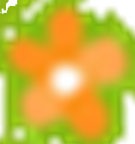
Biodiversity Practical
Part 1: Random sampling
Measure the population size of a species in a habitat.
Procedure:
Use a random number generator to select 10 sets of co-ordinates (where the quadrats will be placed).
Count the number of daisies ( ) and marigold ( ) inside the quadrat (if only part of a flower is inside the quadrat it still counts).
Record the number of daisies and marigold flowers in each quadrat.
Calculate the average (mean) number of each plant in a quadrat.
Quadrat | 1 | 2 | 3 | 4 | 5 | 6 | 7 | 8 | 9 | 10 | mean
daisy
marigold
Notes:
Purpose: carry out required practical7/9 – measure the population size of a common species in a habitat. Use sampling techniques to investigate the effect of a factor on the distribution of this species.
This practical has two parts.
Guidance provided in practical instructions, including possible alternative if it is not possible to take pupils outside.
There is a separate document with guidance for teachers, the pupil instructions can be edited or scaffolded depending on the class ability (e.g. you may want to include more structure for the results sections).
The focus of this investigation is practising sampling techniques but the provided method should be used to compare the effect of a factor on the distribution of organisms so there should be two sets of data recorded, but this is completely up to the teacher.
Easiest examples are to investigate the effect of sunlight or water. To do this the transects would need to cut through areas with different amount of sunlight/shade or varying accessibility to water (i.e. closer to river or water source), then follow the rest of the method.
Pupils are not expected to do any calculations (i.e. percentage coverage or estimate total number of species present) or do any statistical analysis of their results. It is sufficient at this stage to determine if the numbers of organisms are different then there is an effect.
The mathematical skill being checked in this lesson is the calculation of a mean when using random sampling.
The key skill being taught here is measuring the abundance of organisms, but for part 2 it is useful to interleave drawing a conclusion so that pupils can explain the effect of a factor (e.g. water or light intensity). You may also want to use this as an opportunity to get pupils to write a hypothesis for the effect of a factor.

Slide 19
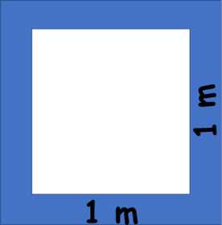
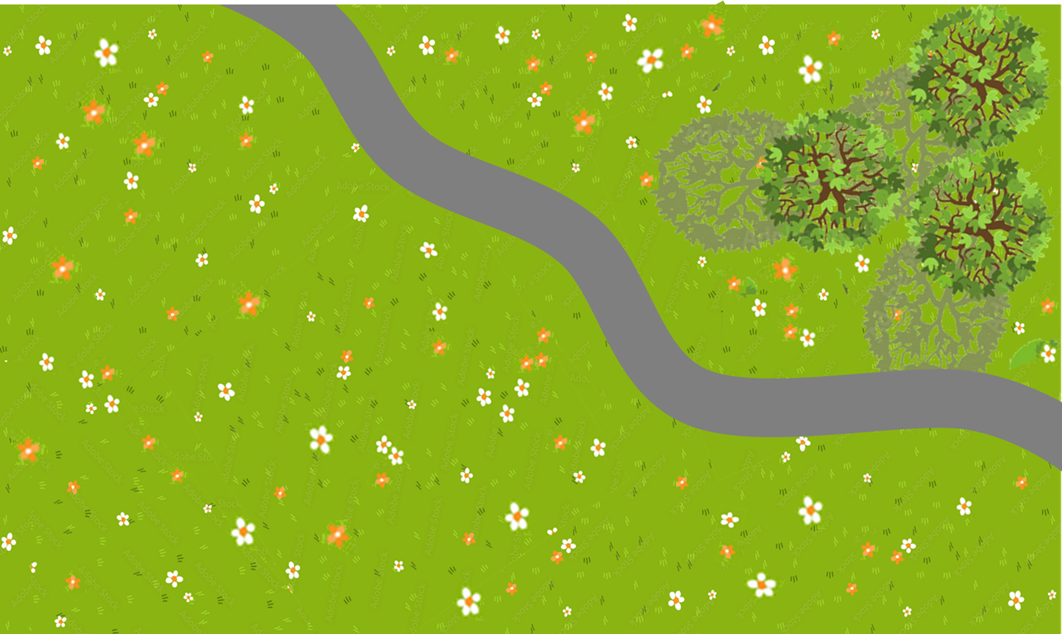
Notes:
Purpose: carry out required practical7/9 – measure the population size of a common species in a habitat. Use sampling techniques to investigate the effect of a factor on the distribution of this species.
This practical has two parts.
Guidance provided in practical instructions, including possible alternative if it is not possible to take pupils outside.
There is a separate document with guidance for teachers, the pupil instructions can be edited or scaffolded depending on the class ability (e.g. you may want to include more structure for the results sections).
The focus of this investigation is practising sampling techniques but the provided method should be used to compare the effect of a factor on the distribution of organisms so there should be two sets of data recorded, but this is completely up to the teacher.
Easiest examples are to investigate the effect of sunlight or water. To do this the transects would need to cut through areas with different amount of sunlight/shade or varying accessibility to water (i.e. closer to river or water source), then follow the rest of the method.
Pupils are not expected to do any calculations (i.e. percentage coverage or estimate total number of species present) or do any statistical analysis of their results. It is sufficient at this stage to determine if the numbers of organisms are different then there is an effect.
The mathematical skill being checked in this lesson is the calculation of a mean when using random sampling.
The key skill being taught here is measuring the abundance of organisms, but for part 2 it is useful to interleave drawing a conclusion so that pupils can explain the effect of a factor (e.g. water or light intensity). You may also want to use this as an opportunity to get pupils to write a hypothesis for the effect of a factor.

Slide 20

Area of field = 7 x 4 = 28 m²
Notes:
Purpose: carry out required practical7/9 – measure the population size of a common species in a habitat. Use sampling techniques to investigate the effect of a factor on the distribution of this species.
This practical has two parts.
Guidance provided in practical instructions, including possible alternative if it is not possible to take pupils outside.
There is a separate document with guidance for teachers, the pupil instructions can be edited or scaffolded depending on the class ability (e.g. you may want to include more structure for the results sections).
The focus of this investigation is practising sampling techniques but the provided method should be used to compare the effect of a factor on the distribution of organisms so there should be two sets of data recorded, but this is completely up to the teacher.
Easiest examples are to investigate the effect of sunlight or water. To do this the transects would need to cut through areas with different amount of sunlight/shade or varying accessibility to water (i.e. closer to river or water source), then follow the rest of the method.
Pupils are not expected to do any calculations (i.e. percentage coverage or estimate total number of species present) or do any statistical analysis of their results. It is sufficient at this stage to determine if the numbers of organisms are different then there is an effect.
The mathematical skill being checked in this lesson is the calculation of a mean when using random sampling.
The key skill being taught here is measuring the abundance of organisms, but for part 2 it is useful to interleave drawing a conclusion so that pupils can explain the effect of a factor (e.g. water or light intensity). You may also want to use this as an opportunity to get pupils to write a hypothesis for the effect of a factor.

Slide 21
Biodiversity Practical
Calculate the number of daisies growing on the field. (field size is 28 m²)
Calculate the number of marigold growing on the field. (field size is 28 m²)
Why are the results different for each groups?
Why are there areas with no flowers growing?
Why should quadrats be thrown (dropped) randomly?
Quadrat | 1 | 2 | 3 | 4 | 5 | 6 | 7 | 8 | 9 | 10 | mean
daisy
marigold
Notes:
Purpose: carry out required practical7/9 – measure the population size of a common species in a habitat. Use sampling techniques to investigate the effect of a factor on the distribution of this species.
This practical has two parts.
Guidance provided in practical instructions, including possible alternative if it is not possible to take pupils outside.
There is a separate document with guidance for teachers, the pupil instructions can be edited or scaffolded depending on the class ability (e.g. you may want to include more structure for the results sections).
The focus of this investigation is practising sampling techniques but the provided method should be used to compare the effect of a factor on the distribution of organisms so there should be two sets of data recorded, but this is completely up to the teacher.
Easiest examples are to investigate the effect of sunlight or water. To do this the transects would need to cut through areas with different amount of sunlight/shade or varying accessibility to water (i.e. closer to river or water source), then follow the rest of the method.
Pupils are not expected to do any calculations (i.e. percentage coverage or estimate total number of species present) or do any statistical analysis of their results. It is sufficient at this stage to determine if the numbers of organisms are different then there is an effect.
The mathematical skill being checked in this lesson is the calculation of a mean when using random sampling.
The key skill being taught here is measuring the abundance of organisms, but for part 2 it is useful to interleave drawing a conclusion so that pupils can explain the effect of a factor (e.g. water or light intensity). You may also want to use this as an opportunity to get pupils to write a hypothesis for the effect of a factor.

Slide 22
Biodiversity Practical
Part 2: Systematic sampling
Investigate the effect of a factor on the distribution of a species
Procedure:
Measure out a line or tape over 10 m, starting from the road.
Place the quadrat at 0 m from the road.
Count the number of organisms in the quadrat.
Move 1 m further along the line or tape, placing the quadrat down at each interval and counting the daisies each time.
Distance from road | 0 | 1 | 2 | 3 | 4 | 5 | 6 | 7 | 8 | 9 | 10
Number of daisies in quadrat
Notes:
Purpose: carry out required practical7/9 – measure the population size of a common species in a habitat. Use sampling techniques to investigate the effect of a factor on the distribution of this species.
This practical has two parts.
Guidance provided in practical instructions, including possible alternative if it is not possible to take pupils outside.
There is a separate document with guidance for teachers, the pupil instructions can be edited or scaffolded depending on the class ability (e.g. you may want to include more structure for the results sections).
The focus of this investigation is practising sampling techniques but the provided method should be used to compare the effect of a factor on the distribution of organisms so there should be two sets of data recorded, but this is completely up to the teacher.
Easiest examples are to investigate the effect of sunlight or water. To do this the transects would need to cut through areas with different amount of sunlight/shade or varying accessibility to water (i.e. closer to river or water source), then follow the rest of the method.
Pupils are not expected to do any calculations (i.e. percentage coverage or estimate total number of species present) or do any statistical analysis of their results. It is sufficient at this stage to determine if the numbers of organisms are different then there is an effect.
The mathematical skill being checked in this lesson is the calculation of a mean when using random sampling.
The key skill being taught here is measuring the abundance of organisms, but for part 2 it is useful to interleave drawing a conclusion so that pupils can explain the effect of a factor (e.g. water or light intensity). You may also want to use this as an opportunity to get pupils to write a hypothesis for the effect of a factor.

Slide 23
Notes:
Purpose: carry out required practical7/9 – measure the population size of a common species in a habitat. Use sampling techniques to investigate the effect of a factor on the distribution of this species.
This practical has two parts.
Guidance provided in practical instructions, including possible alternative if it is not possible to take pupils outside.
There is a separate document with guidance for teachers, the pupil instructions can be edited or scaffolded depending on the class ability (e.g. you may want to include more structure for the results sections).
The focus of this investigation is practising sampling techniques but the provided method should be used to compare the effect of a factor on the distribution of organisms so there should be two sets of data recorded, but this is completely up to the teacher.
Easiest examples are to investigate the effect of sunlight or water. To do this the transects would need to cut through areas with different amount of sunlight/shade or varying accessibility to water (i.e. closer to river or water source), then follow the rest of the method.
Pupils are not expected to do any calculations (i.e. percentage coverage or estimate total number of species present) or do any statistical analysis of their results. It is sufficient at this stage to determine if the numbers of organisms are different then there is an effect.
The mathematical skill being checked in this lesson is the calculation of a mean when using random sampling.
The key skill being taught here is measuring the abundance of organisms, but for part 2 it is useful to interleave drawing a conclusion so that pupils can explain the effect of a factor (e.g. water or light intensity). You may also want to use this as an opportunity to get pupils to write a hypothesis for the effect of a factor.

Slide 24
Answer the questions below.
Biodiversity is…
A. how many plants and animals live in a particular habitat.
B. the number of plants and animals within an ecosystem.
C. the variety of different species in an ecosystem.
2. Which type of sampling would be used to investigate the effect of shade on the growth of flowers in a field?
A. Systematic sampling using a transect and quadrats at regular intervals
B. Random sampling using a quadrat at random coordinates
C. Quadrats randomly placed in a sunny area and a shaded area
3. Why is high biodiversity useful for an ecosystem?
A. So that plants and animals have lots of food
B. It allows animals to have lots of choice when choosing their food
C. It means that a species is not dependent on just one other species
✓
✓
✓
Notes:
Q1. Answer: C
If students answer A or B, they need to practice the definition of biodiversity. To fix it it may be useful to highlight that biodiversity is not necessarily the number of individual organisms within a species but rather the variety of different species. It may also be useful to remind pupils of the effects on a food web if a species becomes endangered/extinct.
Q2. Answer: A
If students answer B or C, they have misunderstood sampling techniques. To fix it you could go through the logic of why systematic sampling has to be used to look for the effect of a factor – if random sampling was used for this it may end up having a large number of samples within one area (e.g. a shaded area) and a small number of samples in another (e.g. a sunny area), which would skew results. Pupils may find it useful to be given a list of scenarios to determine the correct method of sampling to use.
Q3. Answer: C
If students answer A or C, they have not appreciated that organisms rely on each other for reasons other than food. To fix it you might give examples of where organisms rely on each other for a habitat (eg birds and trees) and what the impacts would be if the habitat was removed. For example in a forest with only one type of tree if that species was struck by a disease all trees would be affected so birds would have nowhere to nest. But I a forest with multiple species of tree birds would be less affected as there are other types of tree that may not be affected by the disease.

Slide 25
Lesson B3.2.2
What was good about this lesson? | What can we do to improve this lesson?
Send us your feedback by clicking this link
or by emailing sciencemastery@arkonline.org
Thank you!

